Slide 1


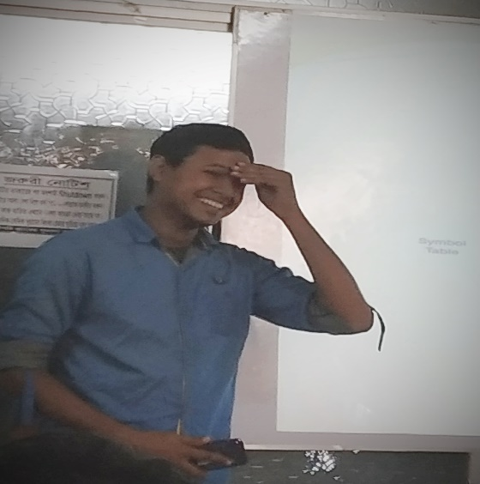

WELCOME TO OUR PRESENTATION
MD.FARUQE HASAN
163432560
ZULKAR-NINE
163432601
SAJEDUL ISLAM
163432559
ABUL HOSSAIN
163432558

Slide 2
PROJECT NAME
E-AGRECULTUR

Slide 3
Abstract
The agricultural information system provides is users to get online information about , fruits, vegetables statistical details and new tendencies.
the main features of the information system includes information retrieval facilities for Farmers are Import product for Bidding from anywhere in the form of obtaining statistical information about fruits, vegetables, statistical information about exports etc. Customer Can buy Crops with bidding.

Slide 4
INTRODUCTION
Bangladesh is a agriculture dependent country . Agriculture is the largest employment in Bangladesh.
Online agriculture is becoming a suitable way to make all your purchases crops, whether you’re at home or anywhere.
Taking to online agriculture to search Crops or service, compare prices & to shop by bidding.

Slide 5
Problem Statement
In Bangladesh, the agricultural sector is one of the main contributors to the national GDP.
An amount of 15.95 %(including fisheries) of the total GDP in the fiscal year 2014-2015 of our country has come from the agricultural sector (BER, 2015).
But, most of the farmers of Bangladesh are still in lack of modern agricultural knowledge and information. People having internet facilities have better access to information, which help them to acquire better position in economic activities.

Slide 6

FEATURES OF E-AGRICULTURAL
Register/login (admin, farmer, user)
Crops Import/Manage
Permission(Admin Management)
Crops category
Update & Delete crops
Database Design
Special Offers
Search System
Import/Export
Crop Bidding
Add to Cart
Comment box

Slide 7
GANTT CHART

Slide 8
Software
Hardware
Sublime text
Xampp
HTML,CSS,JAVASCRIPT,MYSQL
Laravel Framework
Processor 1,6 GHz CPU
RAM 3,5 GB RAM
HDD 1x 40 GB of free space or more is recommended for the software that is listed in the software requirements (system drive)

Slide 9
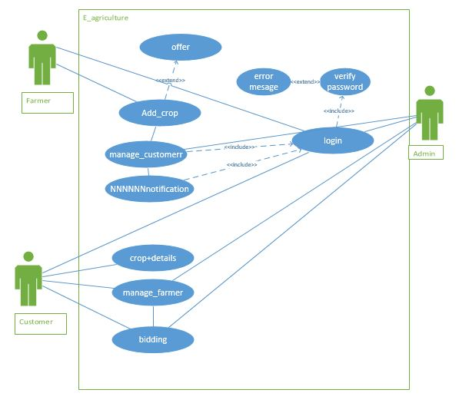
USE CASE DIAGRAM

Slide 10
DATA FLOW DIAGRAM
F_ info
Admin
F - Data
Registration
User data
User
User info
F_data
Farmer
User data
Login
Data Login
User data
F-Data
Import crop
Update &delete crop
Biding

Slide 11
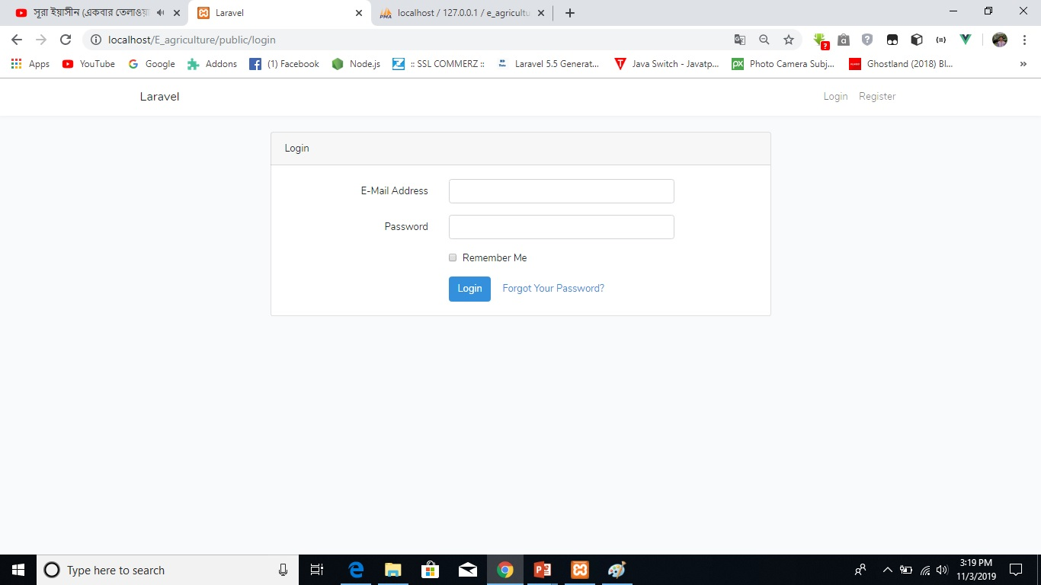
Admin login

Slide 12
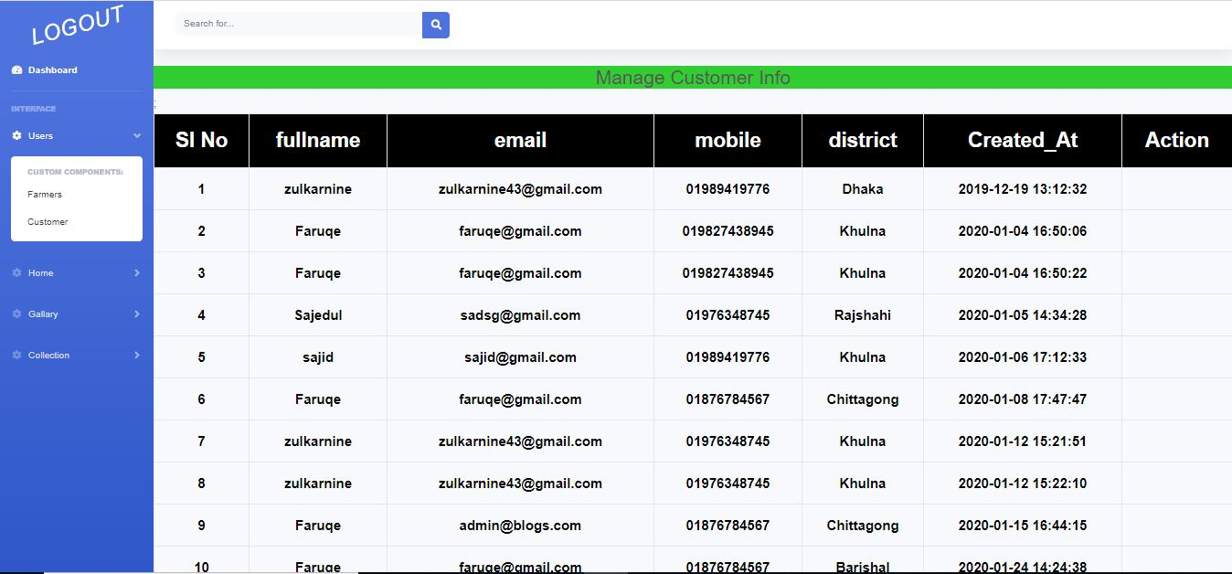
Admin panel

Slide 13
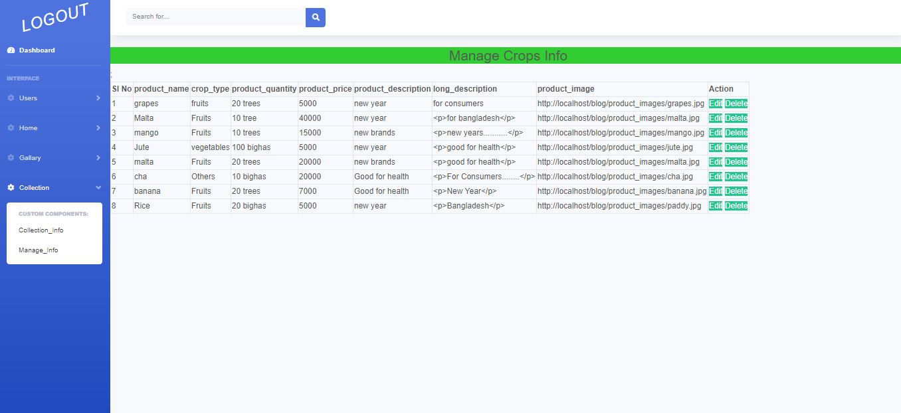
Admin panel

Slide 14
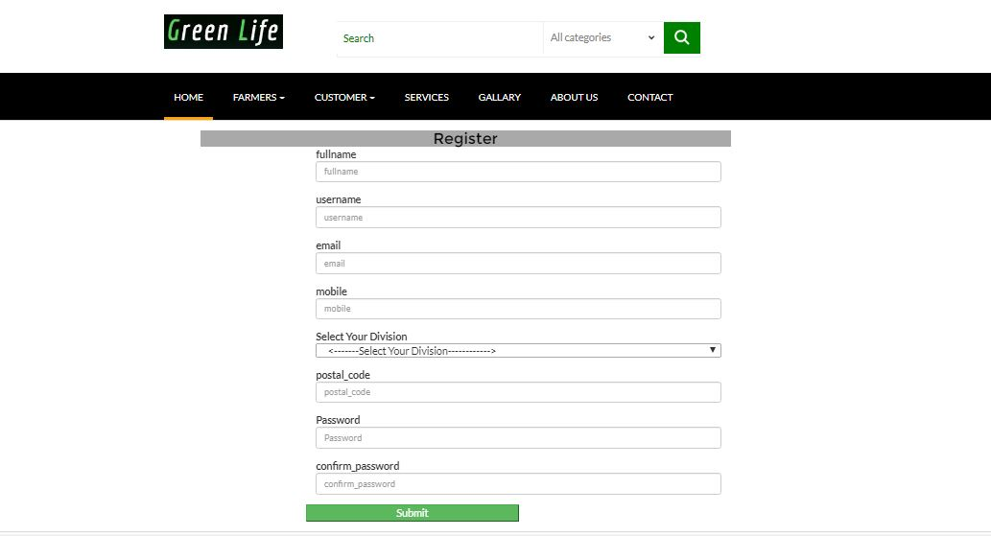
Customer/Farmer register

Slide 15
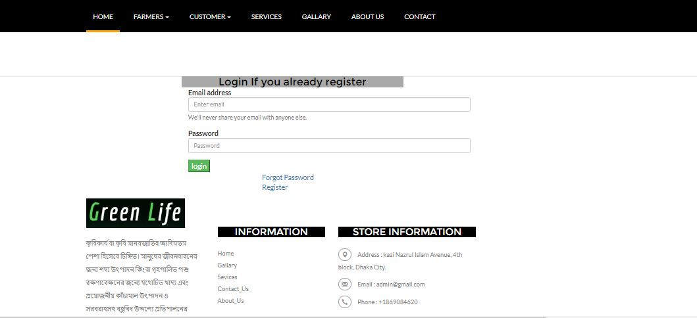
Customer/Farmer login

Slide 16
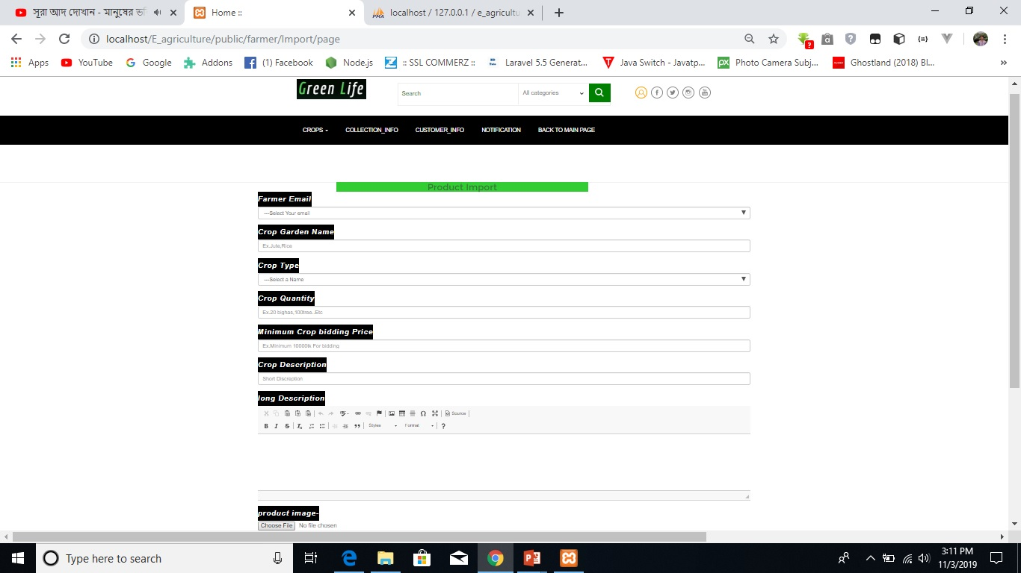
Farmer Import Crop

Slide 17
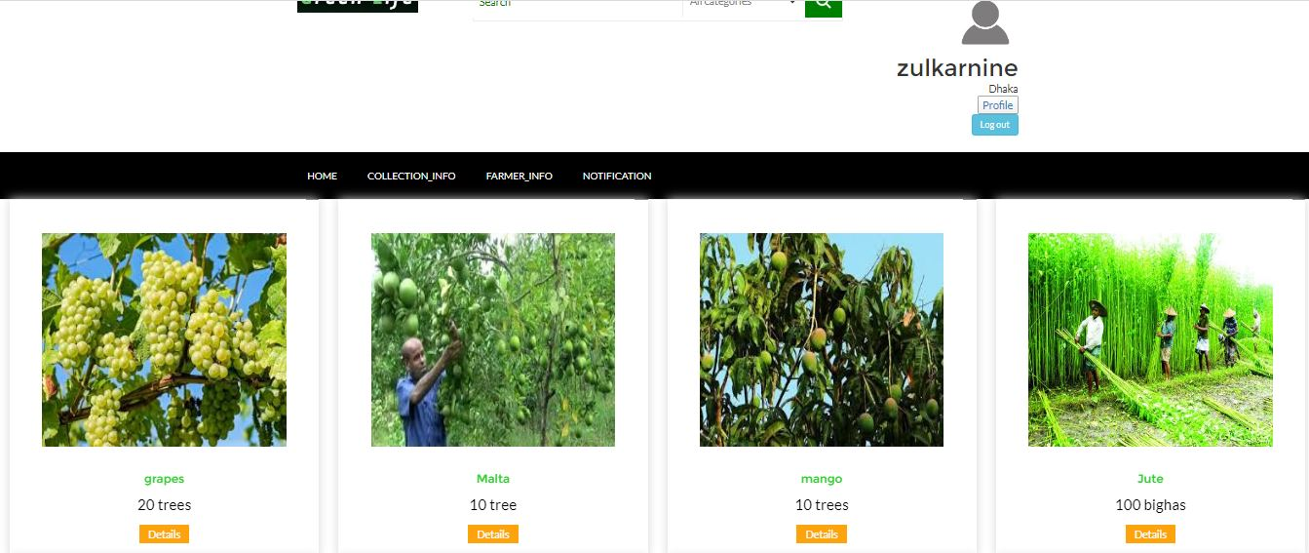
Crop Collection

Slide 18
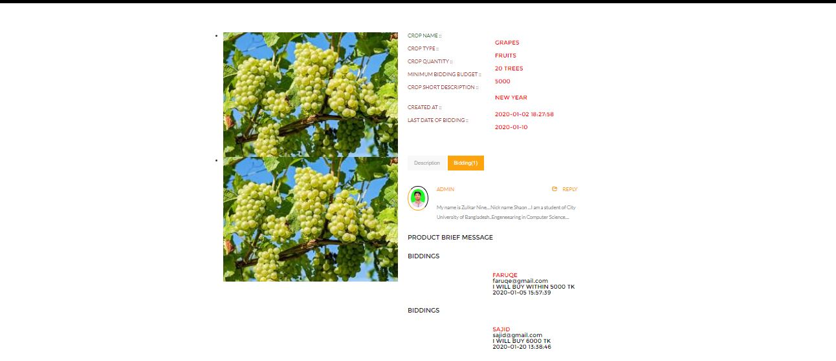
Bidding

Slide 19
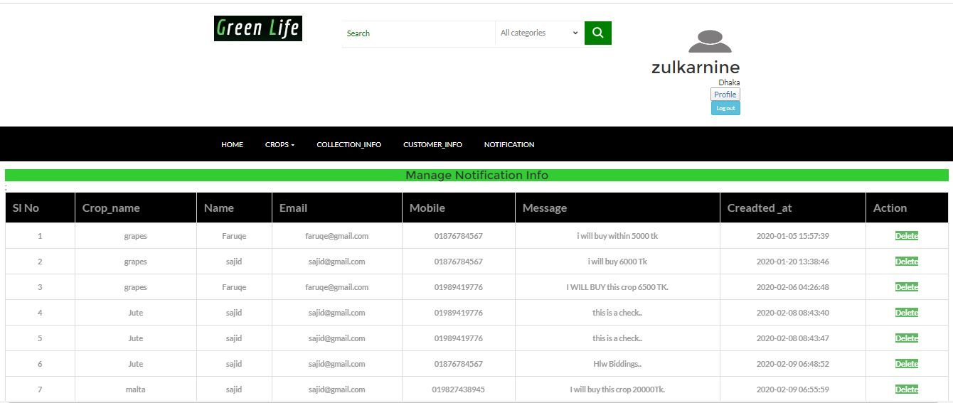
Notification

Slide 20
Advantages
Disadvantages
Save Effort and Time
Easily farmer can sell crops
Customer easily find & buy crops
Increase Additional Cost
Must be Farmer are Experienced with using website
Must be planned When Crops time limited.
May Increase risk of bidding

Slide 21
Future Scope
We will add more feature in day by day .
We will make also android app for this E- Agriculture project.

Slide 22
Thank You

